Slide 1
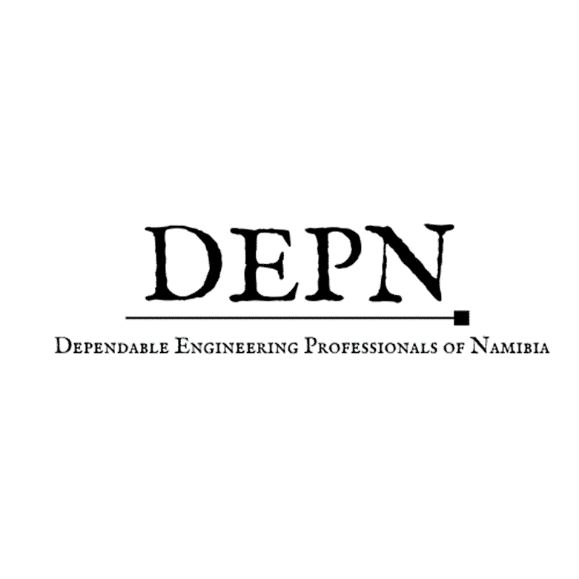
Dependable Engineering Professionals of Namibia(DEPN) Framework

Slide 2

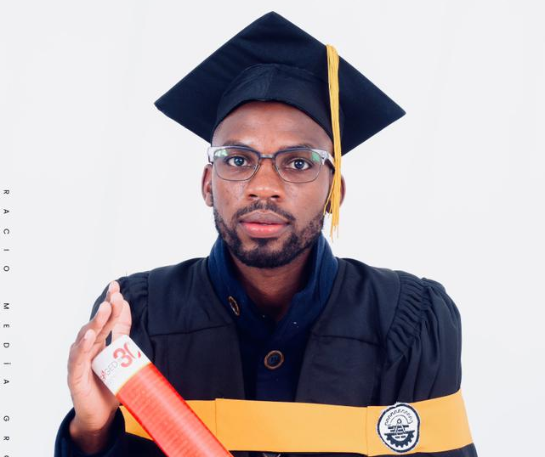

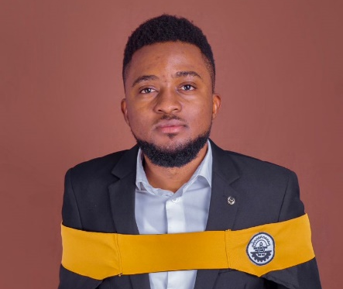
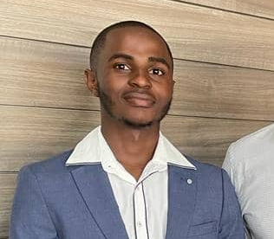
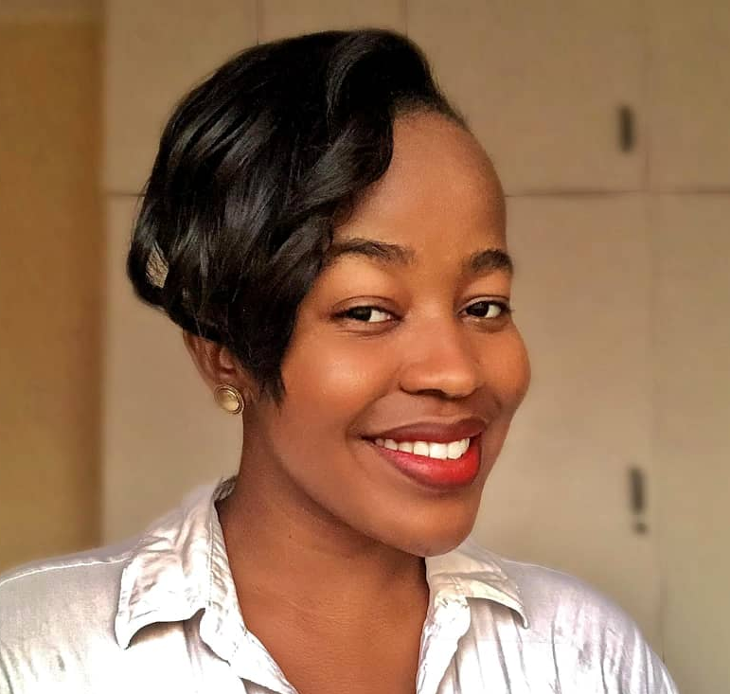
Executive Team
Mr. Jonas T. Abiatar
Founder & President
Mr. Joshua Kalumbu
Technical Director
Mr. Joe Amakali
Operational Strategist
Ms. Febbe Andima
Treasurer
Mr. Elli T.N. Nangolo
Co-Founder & Vice-President
Ms. Beverly Davis
Secretary General
Abiatar Jonas Tulamomwenyo is the President and Managing Director of DEPN. He holds a B.Sc (honours) degree in Metallurgical Engineering(2021) from University of Namibia.
He currently works as a Process Engineer and assistant Project foreman at RenTech Trading CC.
He serves as a technical advisor to the Emerging Mining Association of Namibia(EMAN) and is registered with the Engineering Council of Namibia(ECN) as an Engineer In Training(EIT).
Elli serves a vice president and assists in implementing the DEPN’s objectives. He holds a B.Sc(Honours) in Metallurgical Engineering(2021) from the University of Namibia.
He is presently employed as a Junior Plant Metallurgist at African Tantalum Pty Ltd: Tantalite Valley Mine. He is registered with the Engineering Council of Namibia(ECN) as an Engineer In Training(EIT).
Beverly Davis serves as DEPN’s Secretary General. She’s equipped with LLB Law Honours from University of Namibia (2021).
She presently serves as an Assistant Legal Drafter at Leaseman Property Consultants CC. She was a personal assistant to Principal Agent at Unicorn properties. She is passionate about law and justice.
She’s currently enrolled with her Justice Training Center(JTC) program.
Josh KALUMBU serves as the Technical Director and oversight over analyzing operations and providing cost-effective suggestions for improvement. He has a B.Sc (Honors) in Civil Engineering (2021) from the University of Namibia. He is currently enrolled in a Project Management Programme (PMP) with the University of Stellenbosch. He currently works as a Junior Civil Engineer at Knight Piesold Consulting. He is registered with the Engineering Council of Namibia(ECN) as an Engineer In Training(EIT).
Joe Amakali serves as the Operational Strategist. This entails identify and assist in spearheading projects carried out by DEPN. He holds a Honors degree in Metallurgical Engineering (2021) and currently enrolled in METSIM training course by PATFIO which specializes in process engineering design, flowsheet modeling, plant optimization and project reporting. Currently he’s employed as an Assistant Plant Supervisor at Andrada Mining Company.
Febbe Andima is an aspiring Chartered Accountant and is presently performing Treasurer duties for DEPN. Her tasks encompass financial reporting, advising the board on financial strategy, and strategizing and advising on fundraising for DEPN. She is currently furthering her B.Com Chartered Accountancy degree with the University of Namibia and is a budding entrepreneur in her free time.

Slide 3
Our Organisation
Dependable Engineering Professionals of Namibia (DEPN) is a registered professional engineering organization that takes pride in spearheading innovation that yields accountability and taking ownership of our own economy and resources. Dominated by junior engineers, DEPN aspires to be a key strategy that assists young Engineers in growing their careers through sourcing out mentorships, assists in engaging on Engineering projects for skill transfer, and bring a new dimension to our industry through project research and proposals, outsourcing startups and most importantly benchmark new projects.
Our technical services stretch from feasibility studies and research, project designs and management, metallurgical test works, mineral explorations, and Environmental Impact Assessments (EIA) and Environmental Management Plan(EMP) preparation and partake in mineral exploration activities.
DEPN aspires to be a participating vessel that contributes to a reduced unemployment rates of graduates.

Slide 4
How Did We Get Here?
The realization of DEPN was inspired by the unemployment rate among the graduates. DEPN was realized to assist in spearheading innovative projects that can promote sustainability, industrial integration and most importantly job creation.
Technically, DEPN aspires to emulate organizations such as MINTEK and the Canadian Institute of Mining, Metallurgy and Petroleum. Which have proven to serve the national interest through research, development, technology transfer, promotion of mineral technology and fostering establishment and the expansion of the Mining and Engineering industries.
And through a recognized body such as DEPN (collaboration with established bodies with similar interests) will help take ownership of the responsibility that comes with growing the Namibian Mining, Marine, Recycling and Upcycling, Oil and Gas industry in terms of research development and innovation.

Slide 5
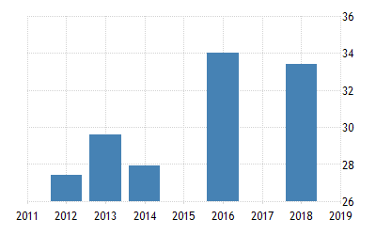
Today’s Situation
Namibia’s unemployment rate is expected to reach 36.70 % (see Figure 1) by the end of 2022, according to Trading Economics global macro models and analysts expectations. This stats is steadily increasing.
Figure 1. Unemployment statistics for Namibia

Slide 6
Vision and Mission Statement
Vision
To be the body that facilitates mining and marine, value addition, Recycling and storage, and Oil and Gas, projects that may potentially result in job creation and industry growth.
The mandate of DEPN is to serve the national interest through research, development, technology transfer, to promote mineral technology as well helping foster the establishment and expansion of industries.
Mission

Slide 7
Goal and Objectives
To foster employment creation for Engineering graduates through innovative green field projects.
Conduct feasibility studies and desktop studies that will help with the development of value addition project to the current mineral resources in the industry.
Develop appropriate technologies that would unlock the country’s economic potential in the Mining, Extraction, Manufacturing, Oil and Gas industry.
Support state priorities in terms of research work and assist the state in achieving technical goals i.e. National Development Plan(NDP)
To grow the technical capacity of young engineers through project collaboration, and develop human capital and organizational skills to build world class R&D excellence.
Engage and collaborate with suitable ministries such as MME and MITSD on priority research areas and feasibility study projects they want to assistance with.

Slide 8
Key Partners
To fulfil our organizational objectives, we are looking for stakeholders to collaborate with.
We would like to partner with
Local authorities
Ministry of Mines and Energy, Ministry of Labour, Industrial Relations and Employment Creation, and Ministry of Trade and SMEs Development.
Private Sector
Universities i.e., UNAM and NUST
Individual role players and experienced role players in the industry
Affiliate with international industry role players such as MINTEK
Chamber of Mines of Namibia
Engineering Council of Namibia
Namibia Society of Engineers

Slide 9
Key Activities & Key resources
Our key activities revolve around the following services;
Feasibility studies and research
EIA preparation
Metallurgical test works and geological exploration
Design, Development and Commissioning of plants
Our key resources is our members. Majority of our members are graduate Engineers, most unemployed and those employed. We also have a pool of registered Engineers who would provide necessary supervision where due.

Slide 10
Our value proposition
Provision of technical services stretching from research, project proposals to project development.
Readily available technical personnel.

Slide 11
Value addition Opportunities
A Metallurgical Laboratory that facilitates analyses of minerals and industrial materials.
Development of small scale mines through active mineral explorations and comminution of Lithium, Graphite, Tin, Tantalum, Niobium, Manganese and Cobalt process and final refined product research and pilot project i.e., Mobile crusher.
Raw material supply required by Mining industry such as Limestone, Sodium Hydroxide as neutralization reagent.
Steel and Aluminum industry i.e. Foundry establishment
Recovery of Copper and Precious metals from E-waste
Hydrogen fuel cells (HFCs) and application of precious metals such as platinum as catalyst in HFCs.
Production of Activated carbon from waste tires.

Slide 12
The 3 years roadmap
6 months
Introduction and affiliation of the organization with all potential stakeholders and industry role players.
Cement relationship with entities we recognize.
1 year
Collaborate with government and private partners to facilitate the development of game changing industrial projects.
Ensure the registration of members with the Engineering Council of Namibia.
Participate in assisting the government achieve the National Development Plan 5(NDP 5).
18 months
Advancements of projects feasibility studies and implementation of some.
Collaborate with International bodies in the Mineral, Mining, Oil and Gas sectors.
2 years
Create new opportunities with international bodies that may result partnering for business ventures.
Ensure a continuous oasis of opportunities with affiliated bodies.
3 years
Implementation of projects and job creation.
Evaluation and continuous progress of developing mega industrial projects.
Grow a larger business network that provides a conducive environment for the youth to thrive.

Slide 13
Thank You!

